Slide 1
Final Project Presentation
Neil Marks

Slide 2


Snake Using the Logisim Processor
The classic game Snake run in Logisim by the processor I created
Controlled by the A/S/D/W keys to navigate the snake around the area
As the snake eats the apples, it grows in length
If the snake head hits itself or the border, then the game is over

Slide 3
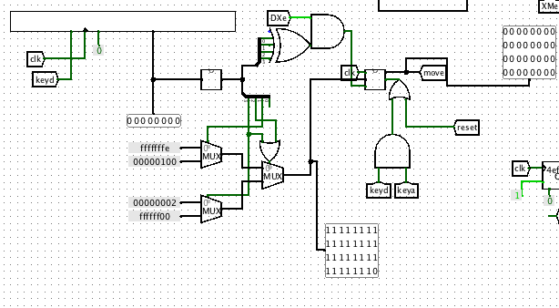
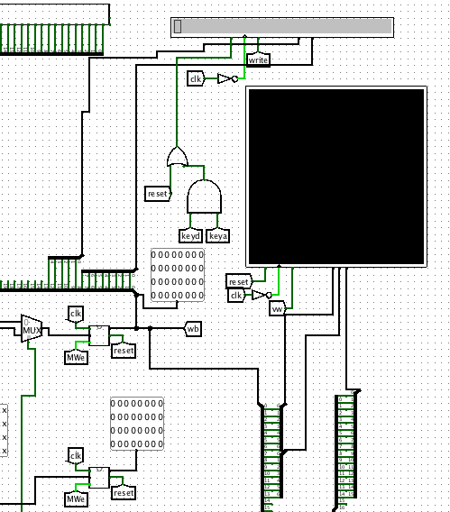
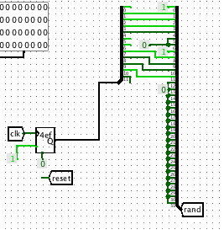
Additions to the Processor
Integrated a video LCD display, keyboard queue input, LCD text output, and random number generator into the processor

Slide 4
Custom Instructions Added
vid $rd, $rs, N
Writes the color specified by the lower 16 bits of N to the video display at the location of $rd + $rs with the lower 8 bits being the x location and bits 8-15 being the y location
key $rd
Writes the decoded direction specified being stored in the direction register to $rd
write $rd, $rs, N
Writes the character specified by the lower 8 bits of $rs + N to the location specified by bits 8-12 of $rs + N
rand $rd
Writes the randomly generated odd number to $rd

Slide 5
Mips Code Flow Chart
Update Score
Apple Here
Initialize Borders
Initialize Snake Head Location and First Apple
Input Move and Check Next Head Location
Move Snake
Nothing here
Border or Snake Here
Game Over;
Remove Snake

Slide 6
Final Product
Accomplishments
Challenges
The game plays completely correct
All output and input devices were correctly incorporated into the processor with their instructions
The timing is constant for almost whatever happens in the game (33 clock cycles per move)
The score is output in decimal form
A successful reset was established by a back to back key instruction
The clock in Logisim never achieved a high enough frequency to allow smooth movement (more like an inchworm instead of a snake)
Using the premade inputs/outputs as the keyboard queue is not ideal (i.e. holding a key puts it in the queue a lot)
The game had to be scaled down to run more efficiently

Slide 7
Demonstration

Slide 8
